Slide 1



UNIT 2
Lesson 6
What’s with you?
Part 1

Slide 2
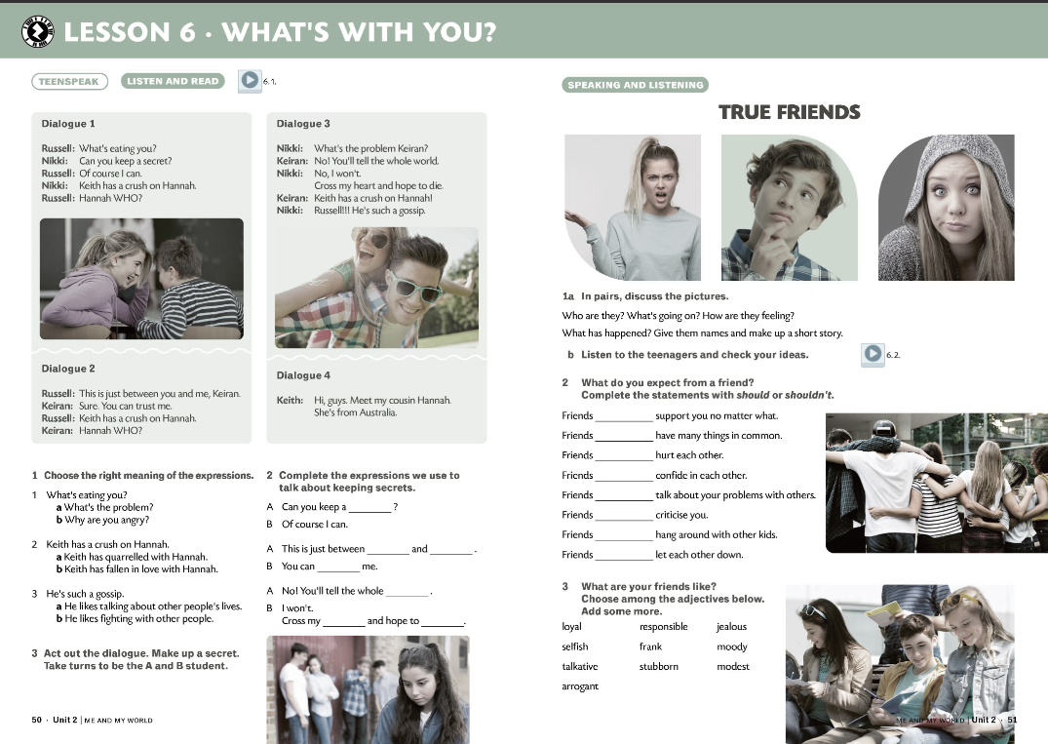

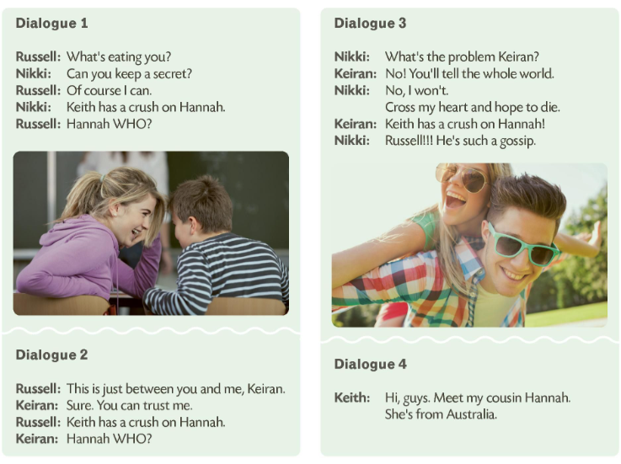
A GOSSIP
a conversation or reports about other people's private lives
someone who enjoys talking about other people and their private lives

Slide 3
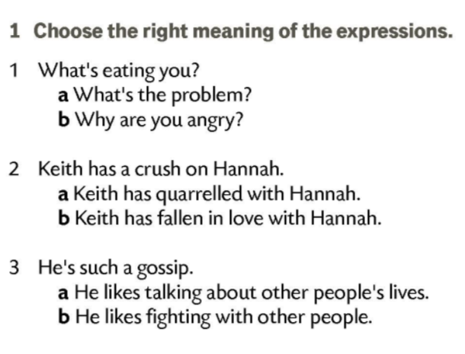
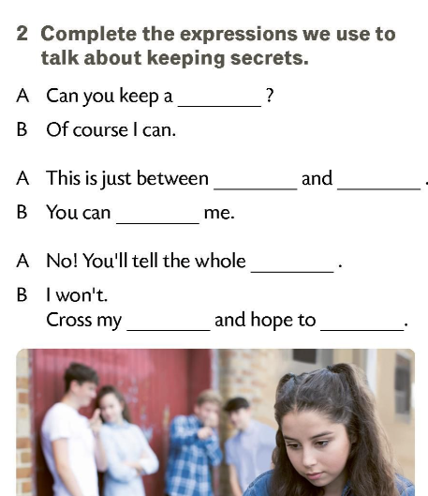
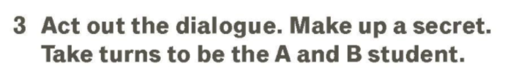
secret
you
me
trust
world
heart
die

Slide 4
support someone no matter what
podržati nekoga bez obzira na sve
support someone no...
have many things ...
confide...
hang around...
criticise...
write to…
fall out with…
tell a white...
feel jealous…
break...
a problem page
a friend
in common
a promise
lie
matter what
in someone
with someone
a friend
of a friend
have many things in common
imati mnogo zajedničkih interesa
confide in someone
povjeriti se nekome
hang around with someone
družiti se s nekim
criticise a friend
kritizirati prijatelja
write to a problem page
pisati na stranicu problema
fall out with a friend
posvađati se s prijateljem
tell a white lie
reći bijelu laž
feel jealous of a friend
biti ljubomoran na prijatelja
break a promise
prekršiti obećanje

Slide 5
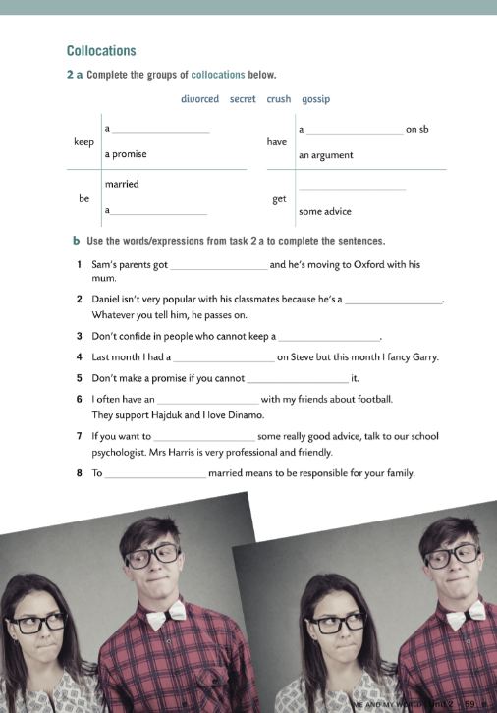
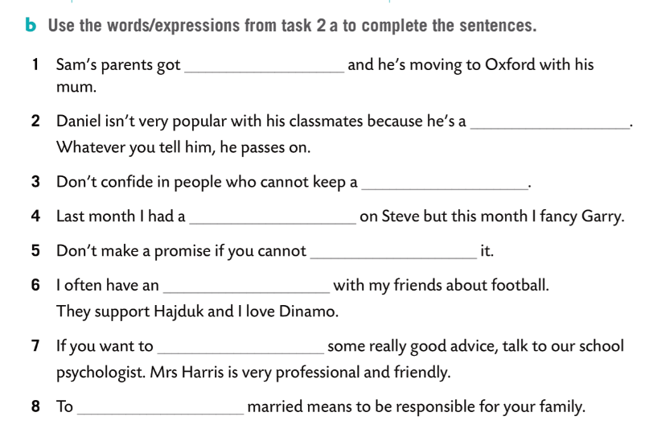
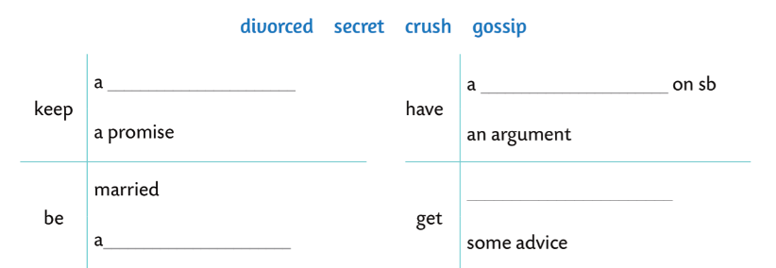
divorced
gossip
secret
crush
keep
argument
get
secret
crush
be
divorced
gossip

